Slide 1
Windows 365: From zero to cloud in one hour!
Jens Du Four
Notes:
45 min + 5 min Q&A
Are you curious about Windows 365? In this session, I will guide you through the entire process of setting up Windows 365 from scratch. You will learn everything you need to know to get started with the next step for Windows. Join me to discover the ease and convenience of Windows 365.

Slide 2
Agenda
Who am I?
What is Windows 365?
Multiple license types?
The (easy) setup!
What’s next?
Q&A

Slide 3

Who am i?
Jens Du Four
LinkedIn.com/in/jensdufour/ – jensdufour.be
CETS @ Microsoft BeLux
Bourgandier (I like all things good about life)
Travelling
Hiking/Diving/...
Talk to me!

Slide 4
Microsoft transformed the Office experience with Office 365. Microsoft transformed the Windows Server experience with Azure. We want to transform the Windows experience with Cloud PC.

Slide 5
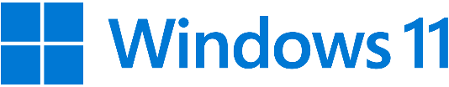
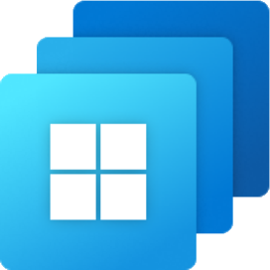


Native on a PC or Tablet
Cloud VDI with Azure Virtual Desktop
Cloud PC on any device with Windows 365
across price points and form factors
optimized for flexibility and control
optimized for experience
Evolutionary
Revolutionary

Slide 6
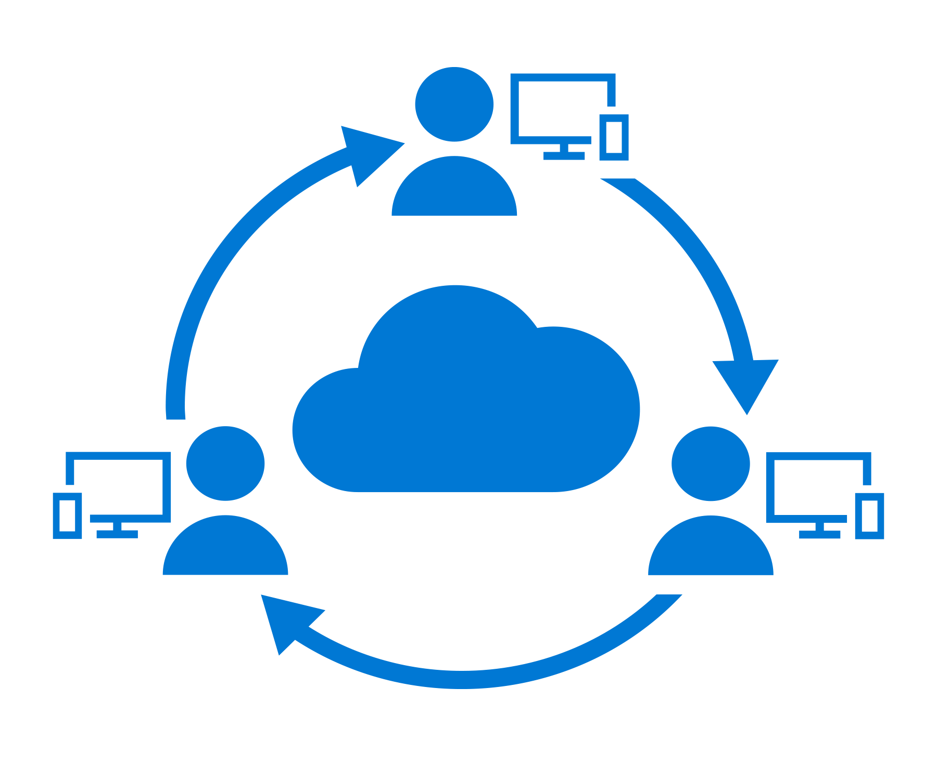
Windows 365 Enterprise vs Frontline
Windows 365 Enterprise
Windows 365 Frontline
For employees who need anytime access to their Cloud PC
For frontline workers who need access to their Cloud PC during their shift
Dedicated Cloud PC access 24/7
Cloud PC access only during their shift
Each employee requires a license
Provision any 3 employees with a single license
Personalized, full Windows experience
Personalized, full Windows experience
Deploy and manage in Microsoft Intune
Deploy and manage in Microsoft Intune

Slide 7
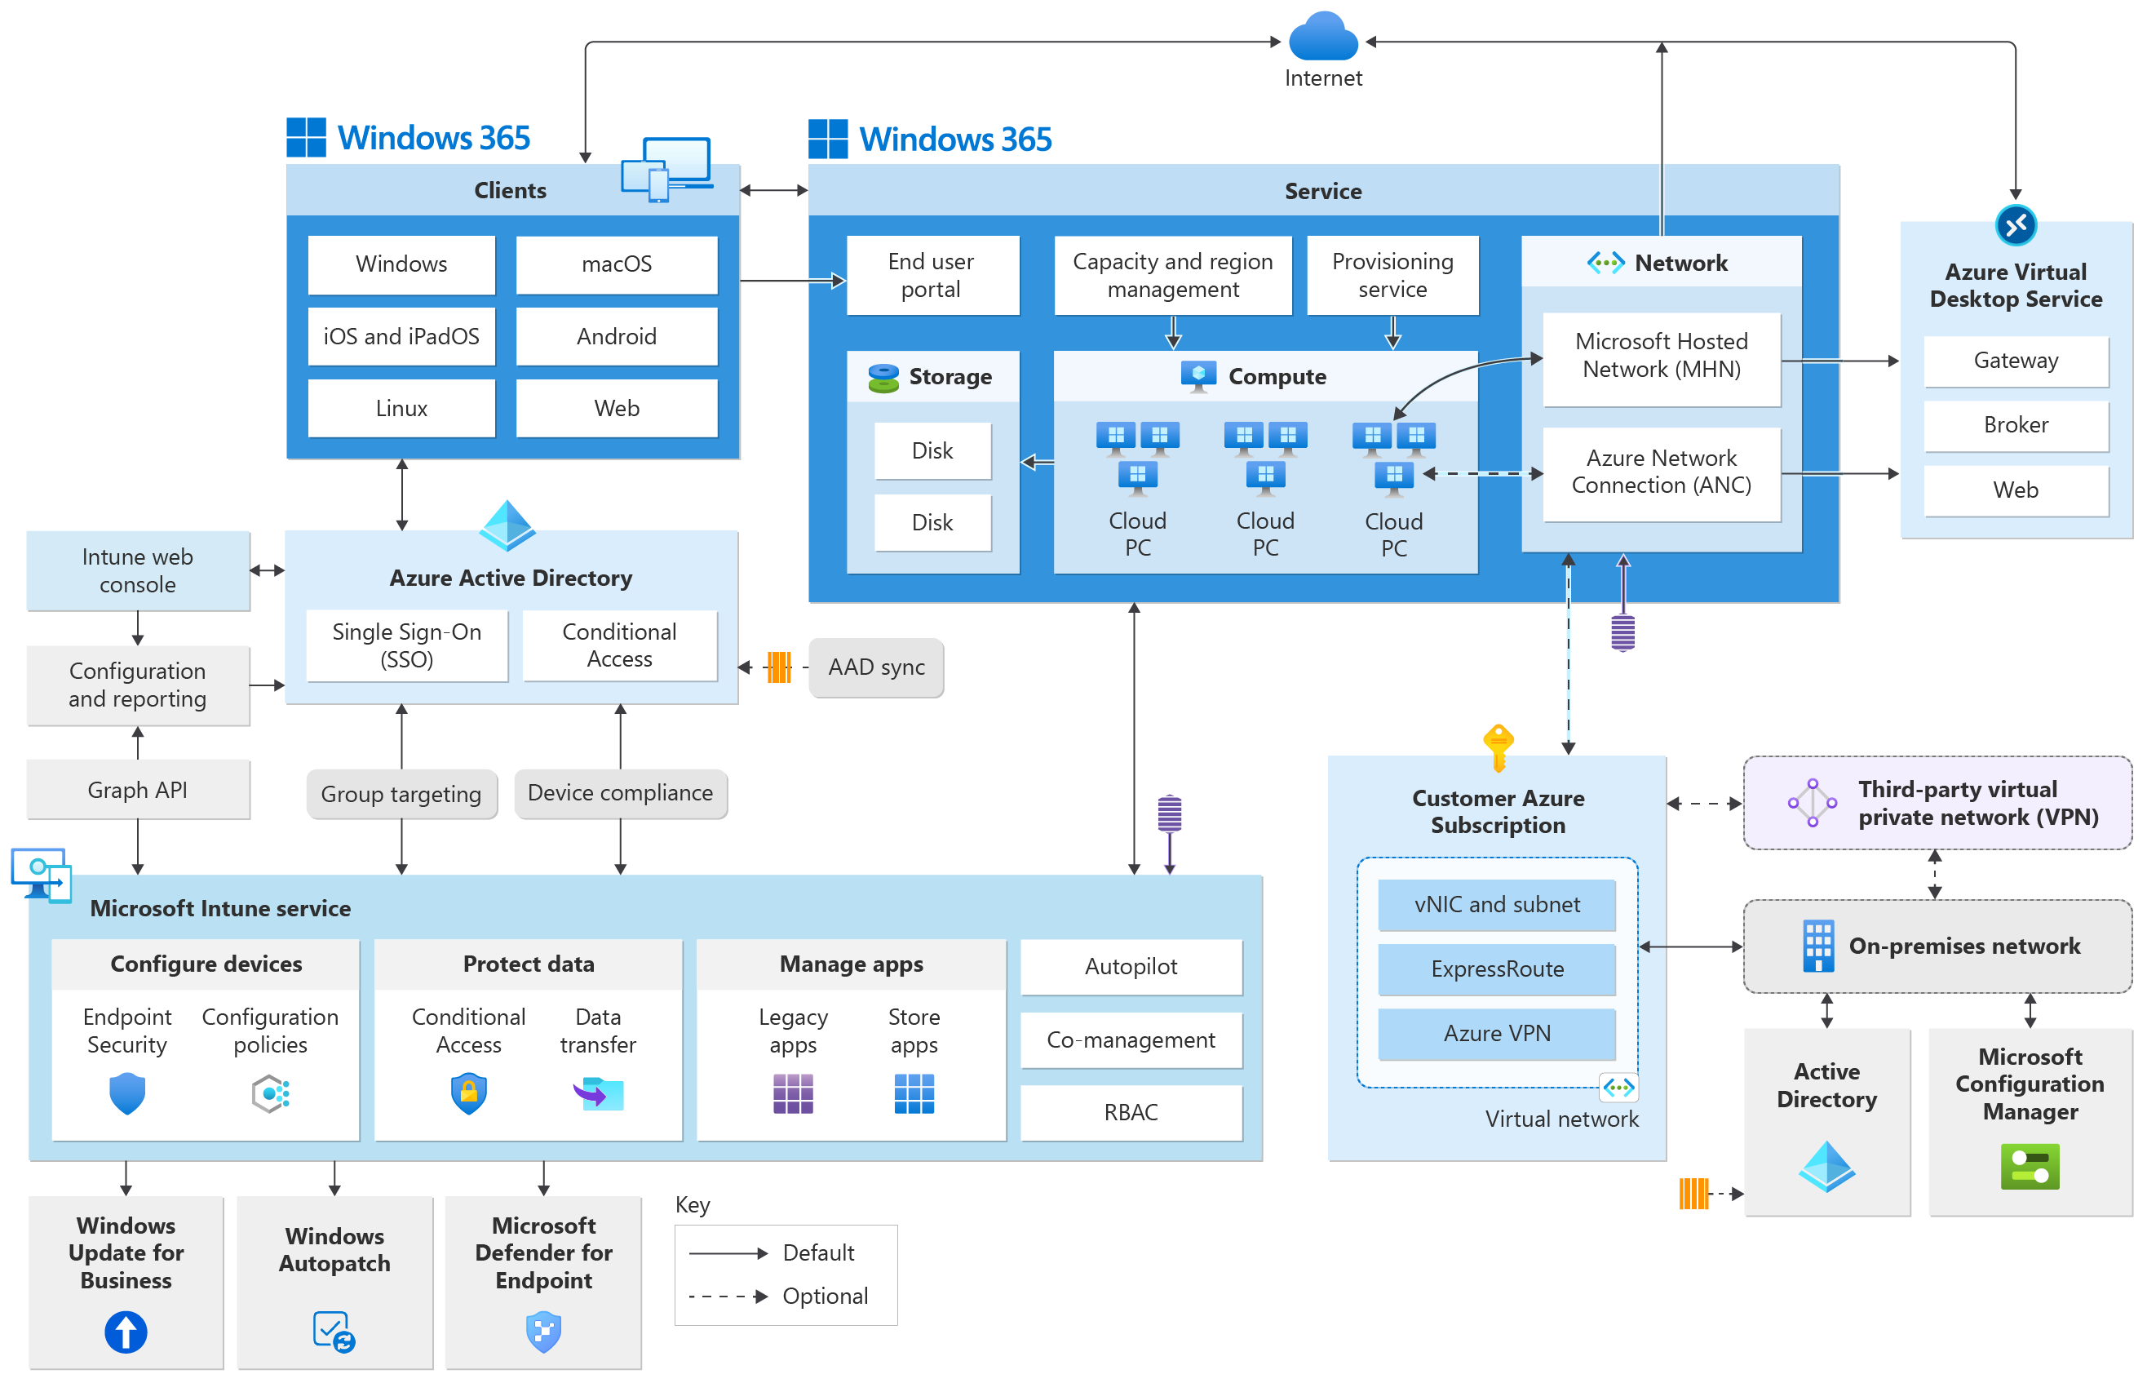
Entra ID

Slide 8
Create ANC (optional)
Creation of the Azure Network Connection for the deployment of Microsoft Entra Hybrid Join Cloud PCs
Assign Windows 365 licenses
Assign the relevant Cloud PC license to a user or group
Create the provisioning policy
Create the policy that outlines all settings for the Cloud PC creation
Create user settings and/or custom images (optional)
Create user settings to allow for restore points, local admin…

Slide 9
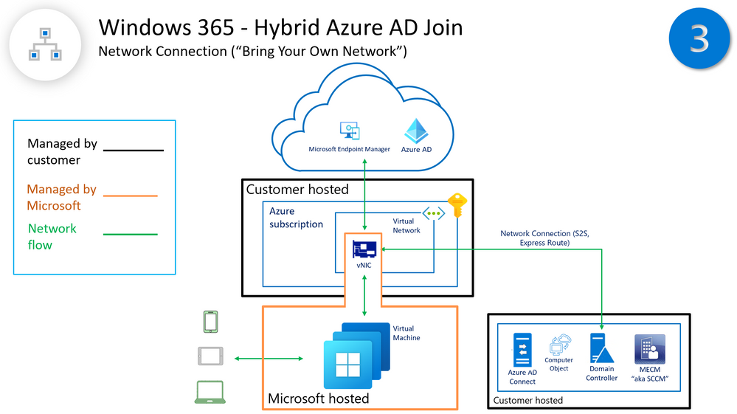
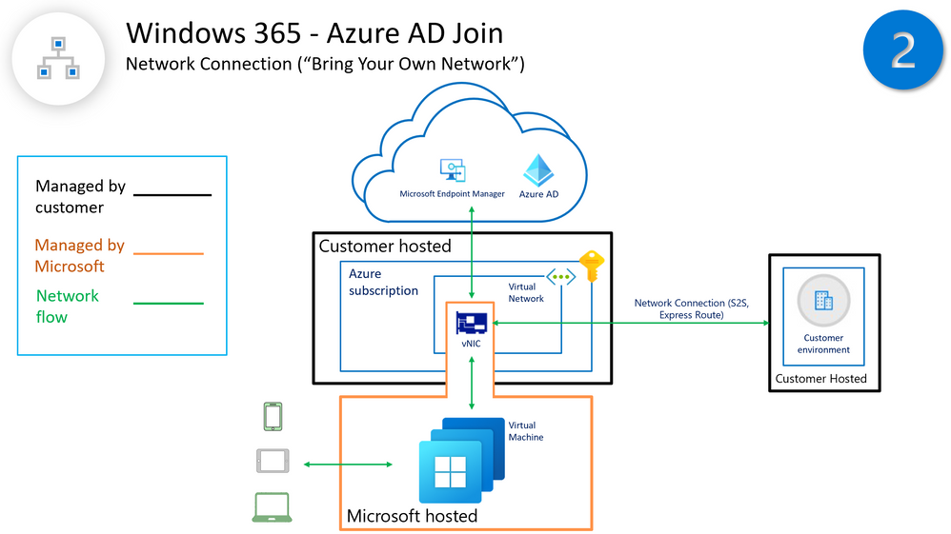
Create the azure network connection

Slide 10
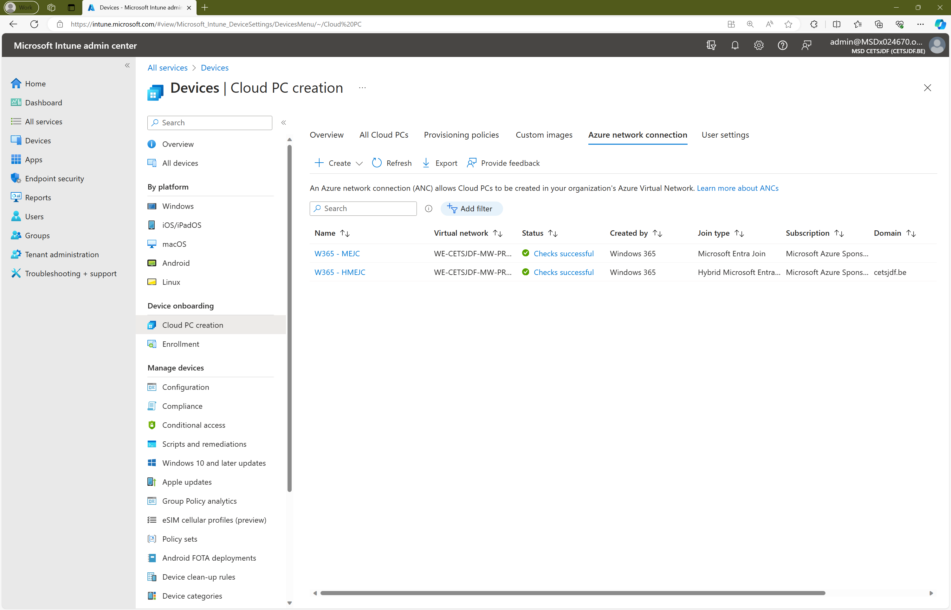
Create the azure network connection

Slide 11
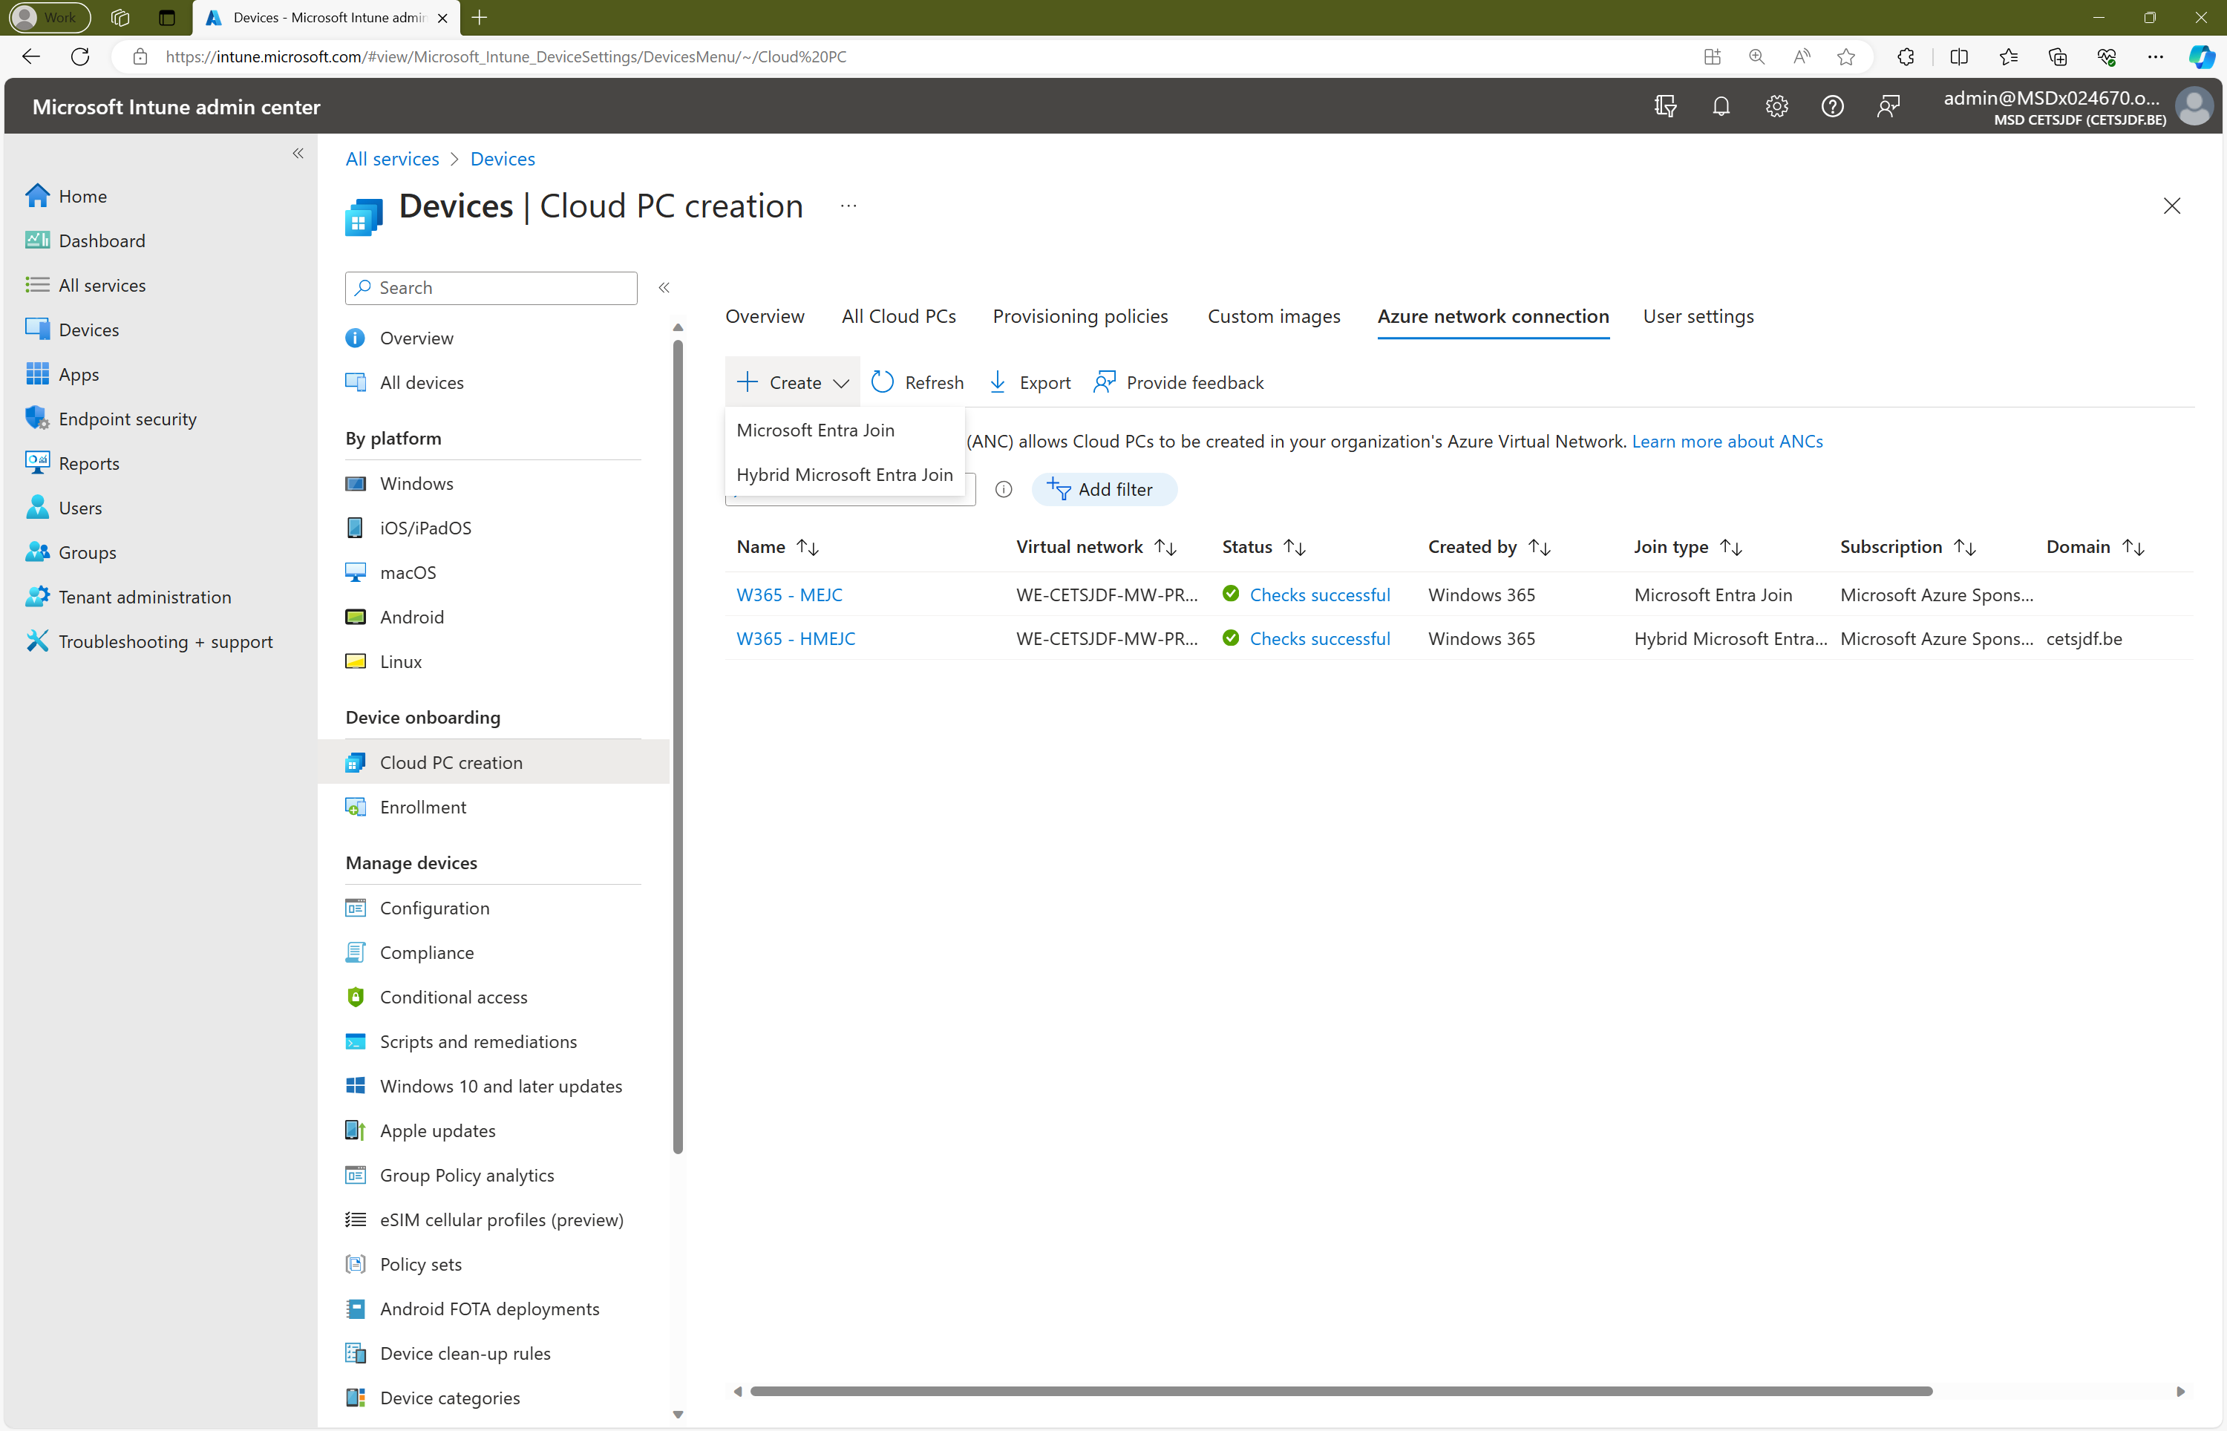
Create the azure network connection

Slide 12
Create the azure network connection

Slide 13
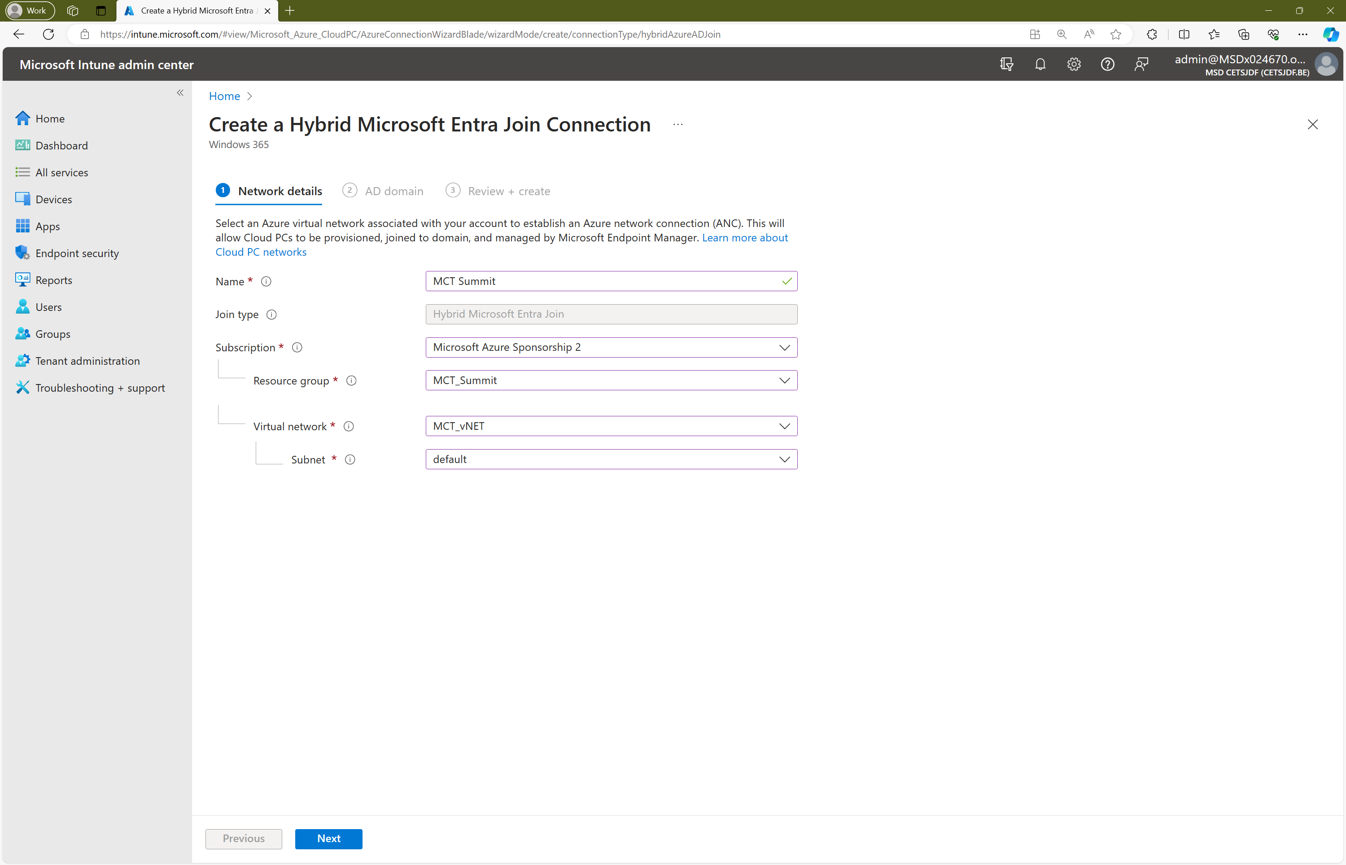
Create the azure network connection

Slide 14
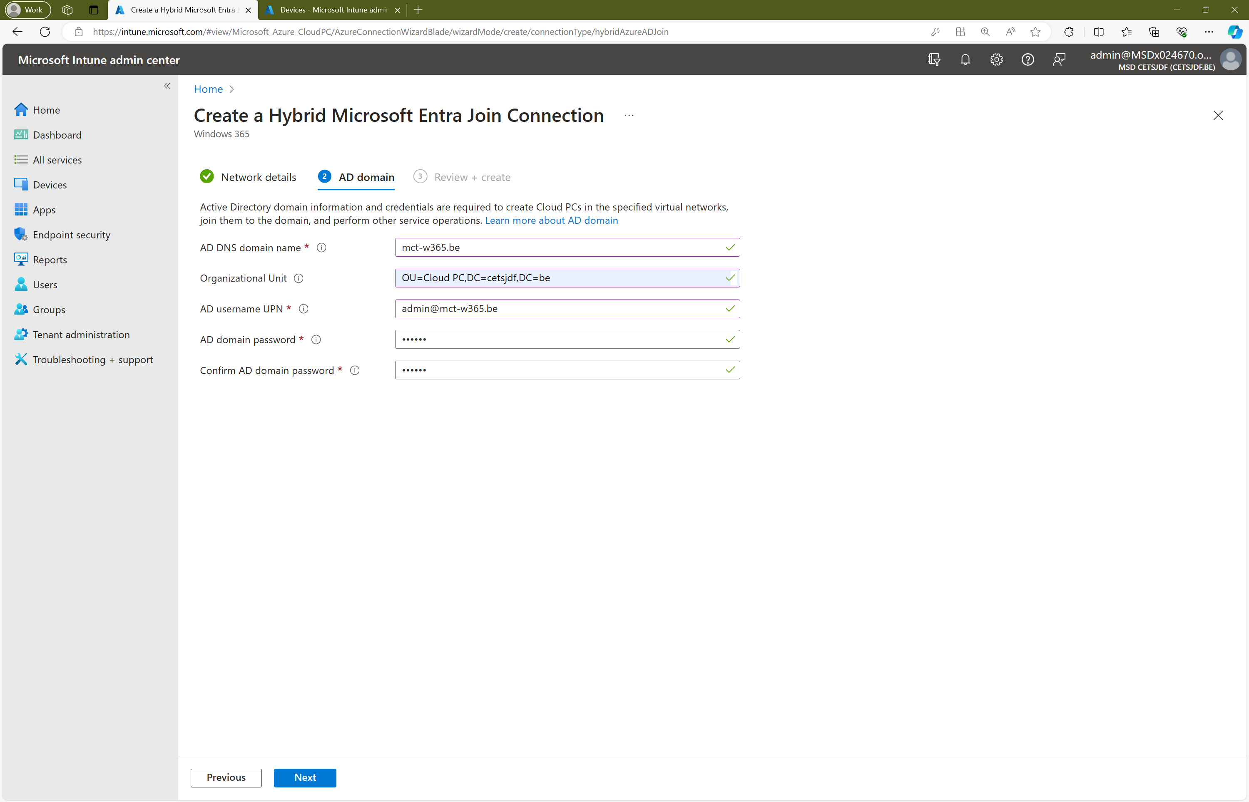
Create the azure network connection

Slide 15
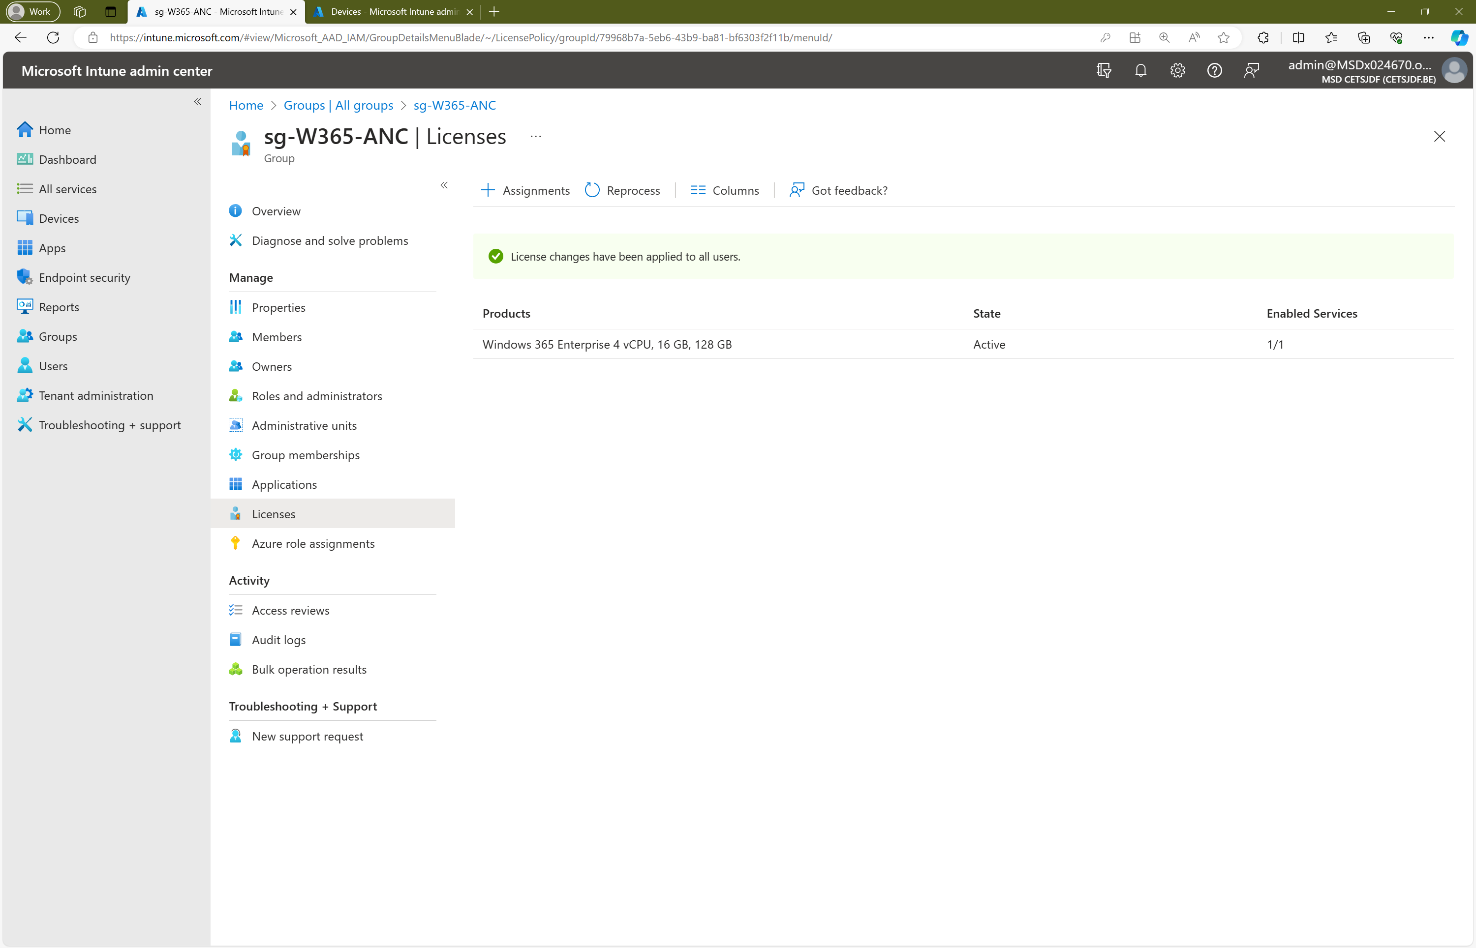
Assign the windows 365 licenses

Slide 16
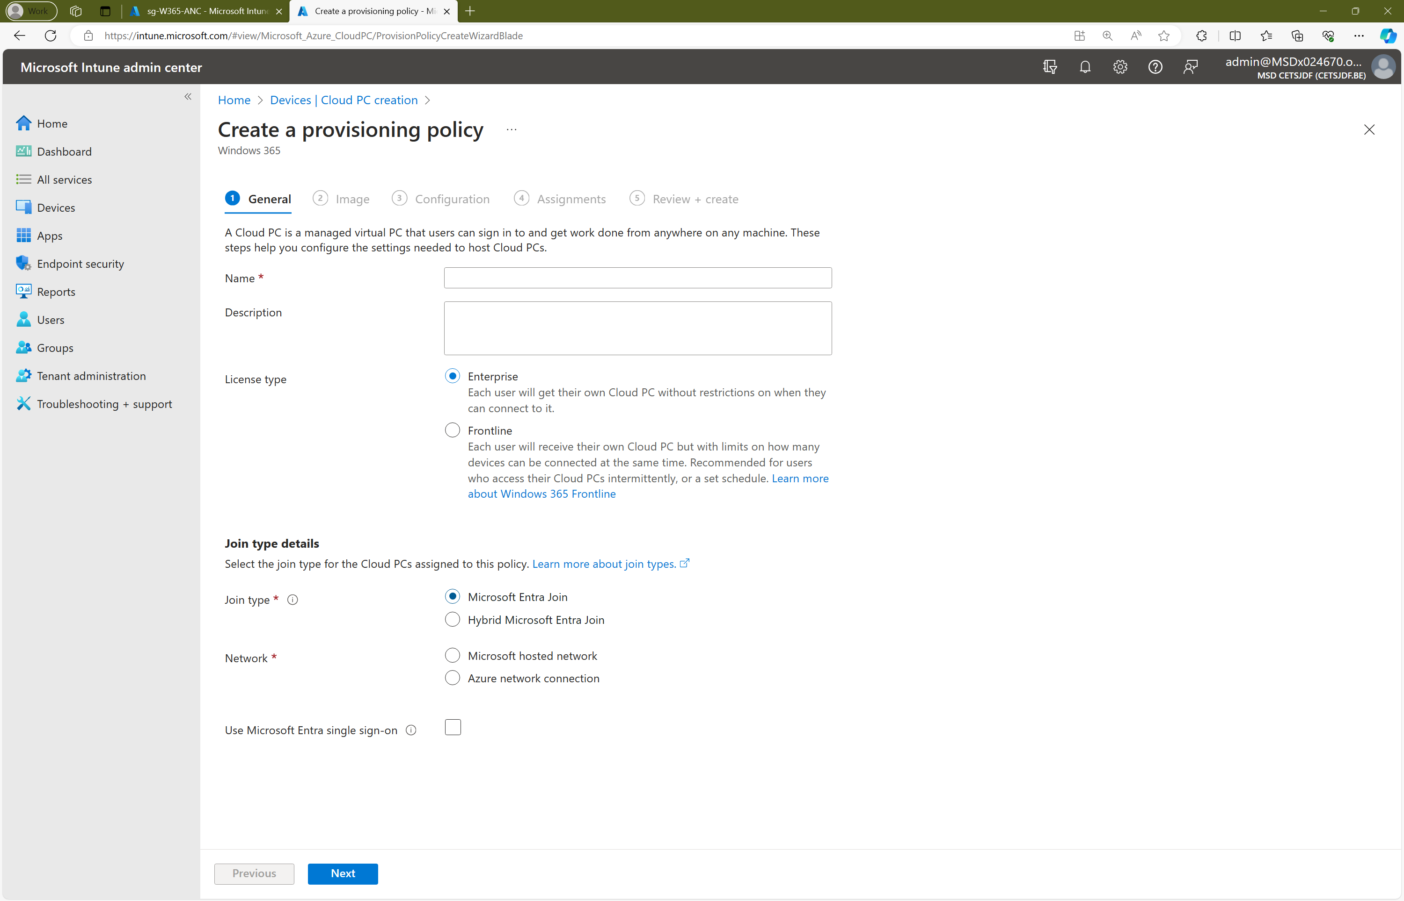
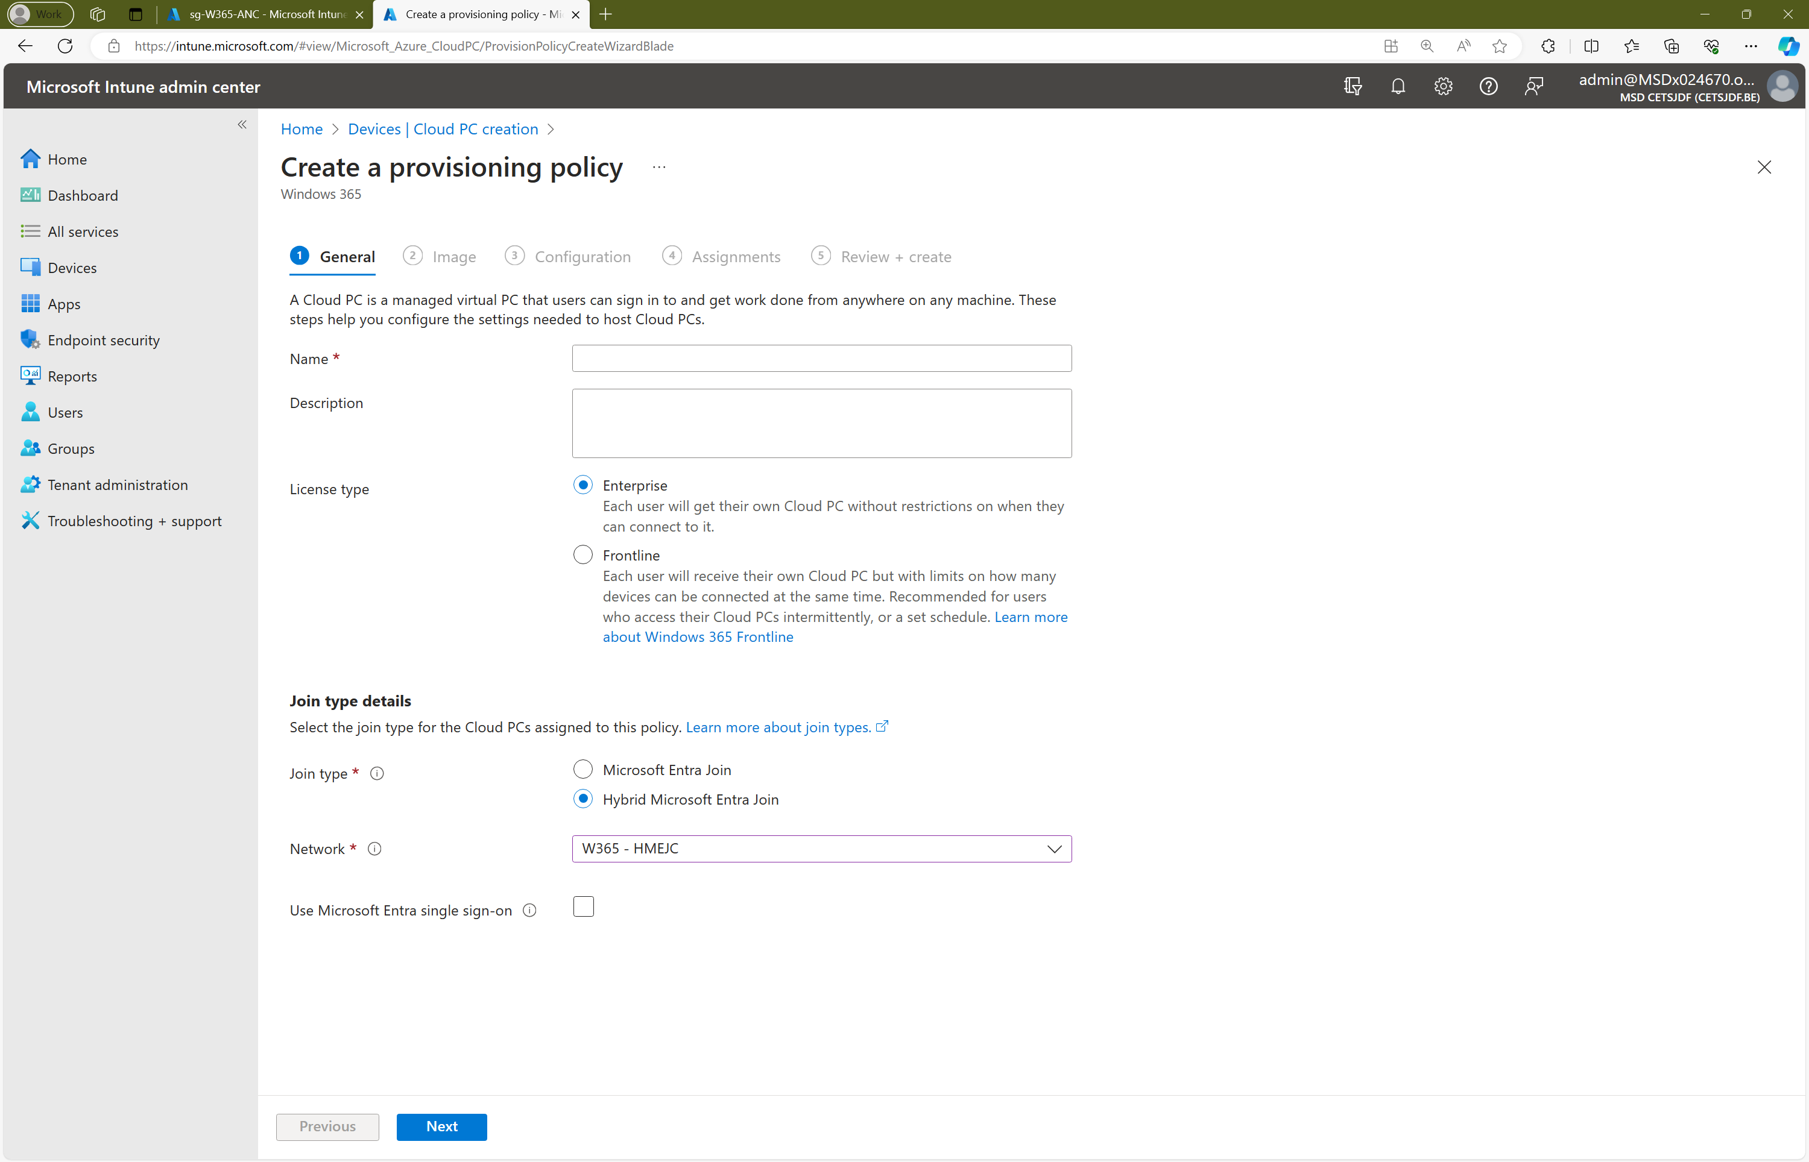
Create the provisioning policy

Slide 17
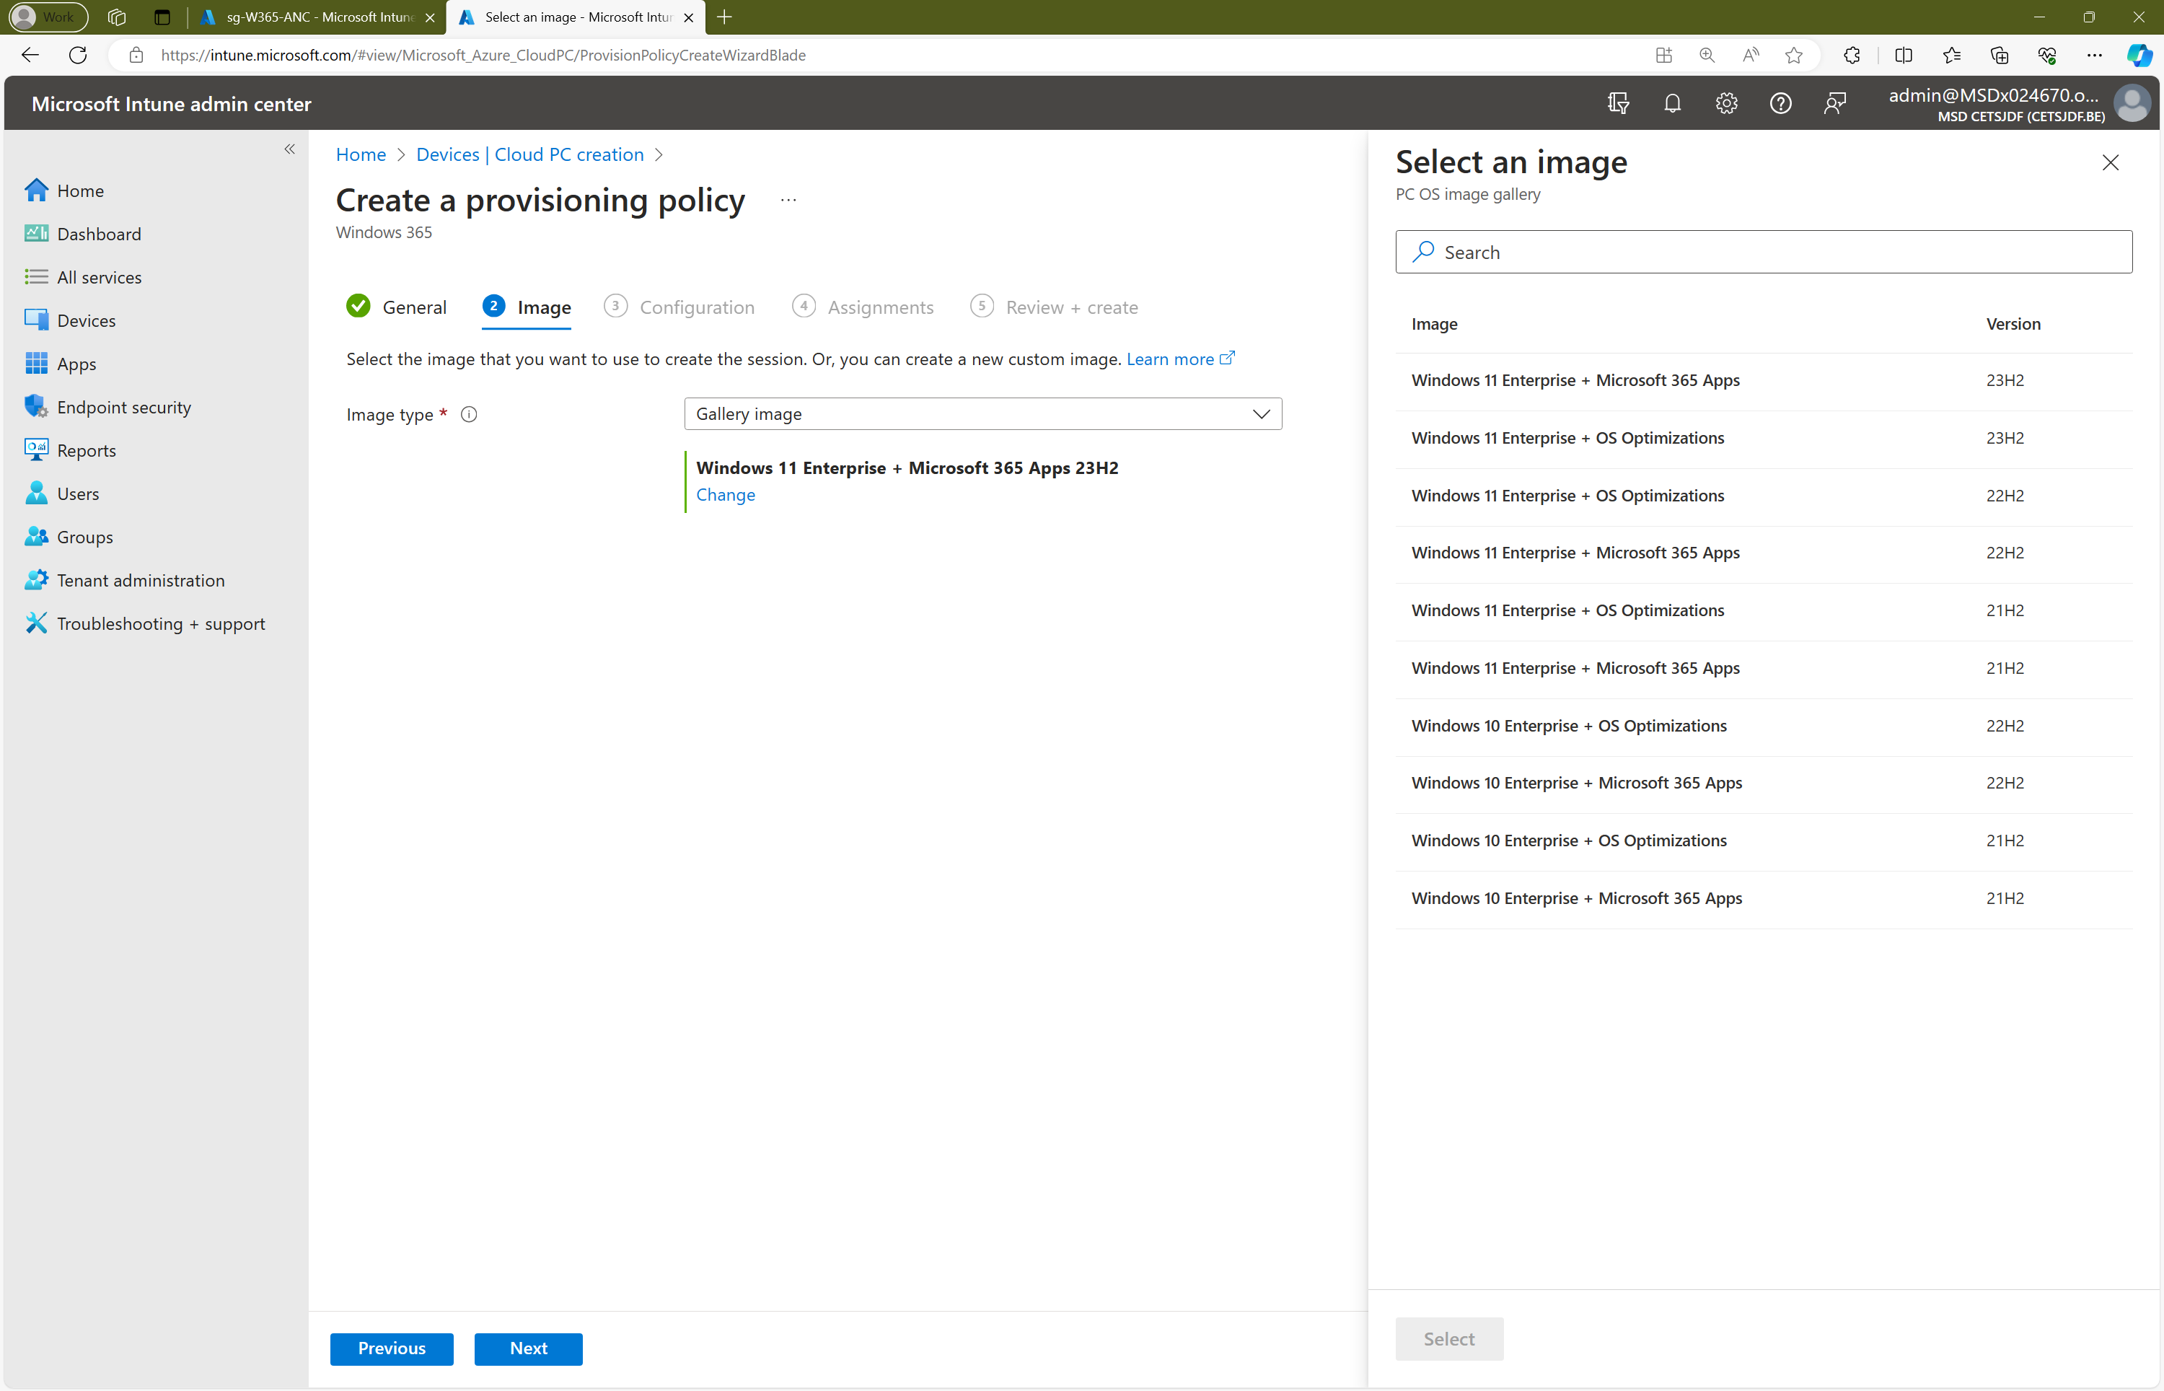
Create the provisioning policy

Slide 18
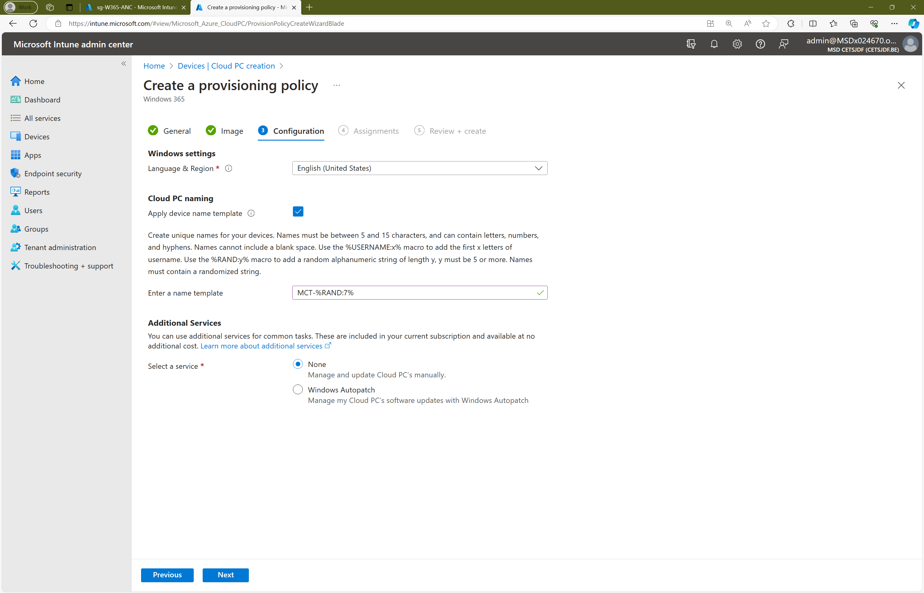
Create the provisioning policy

Slide 19
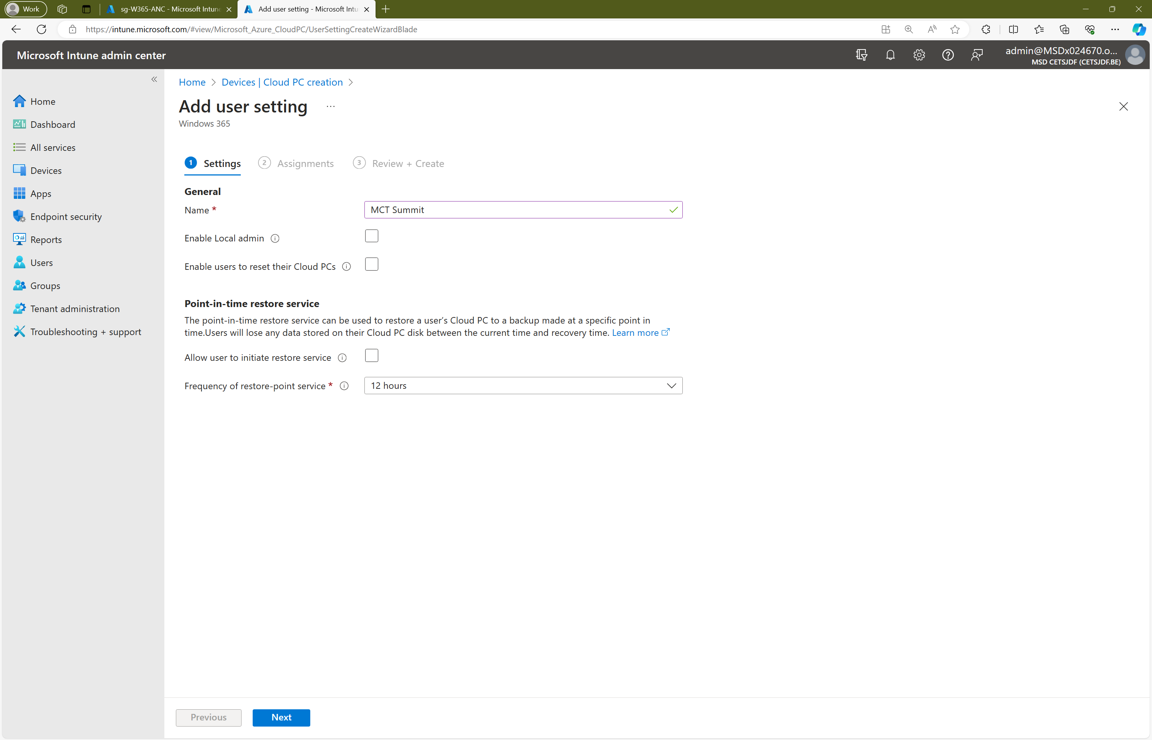
Optional steps

Slide 20
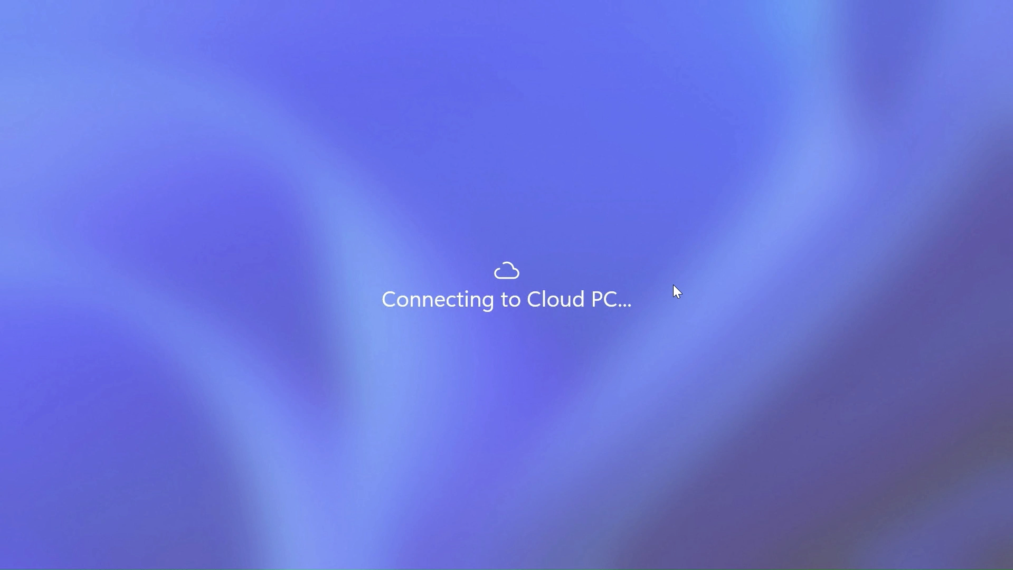
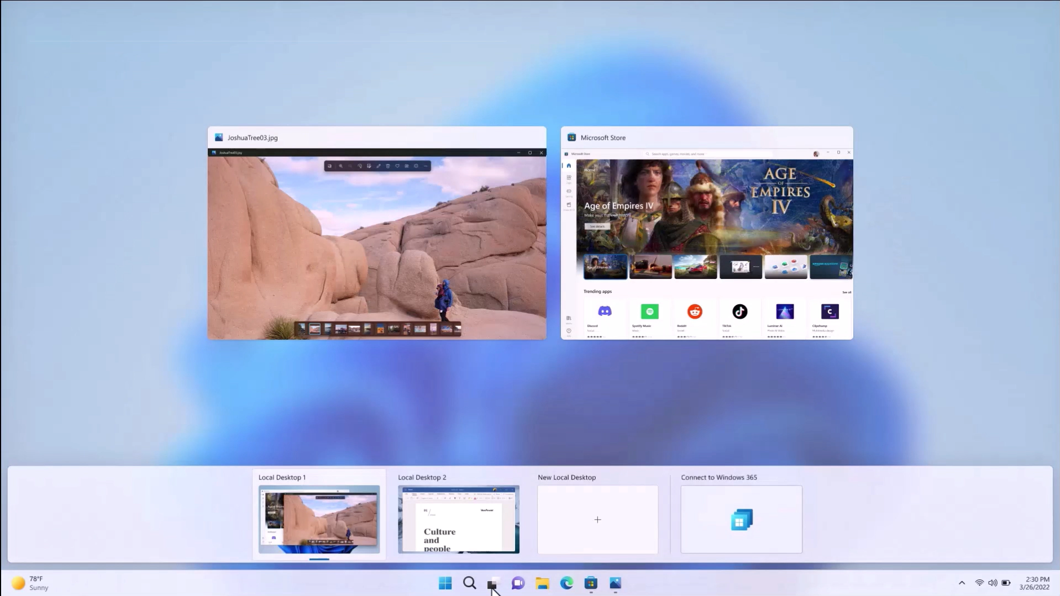

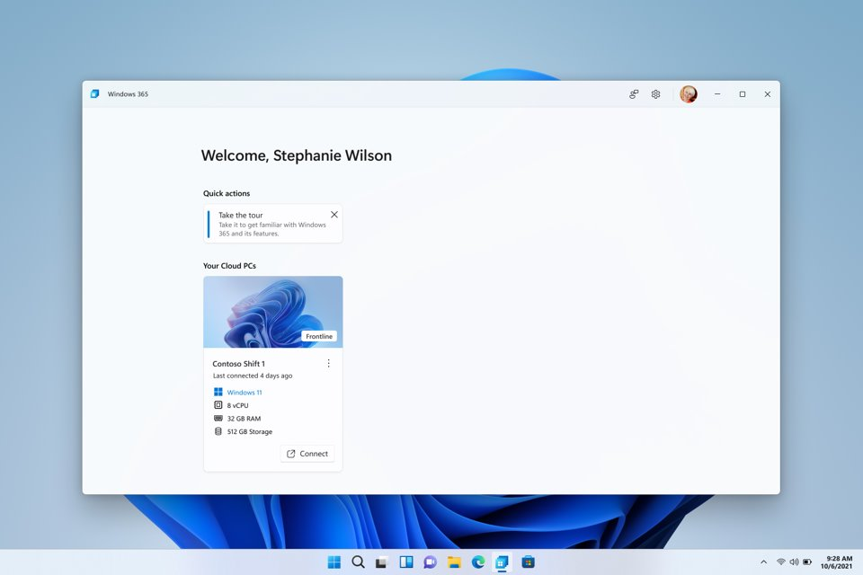
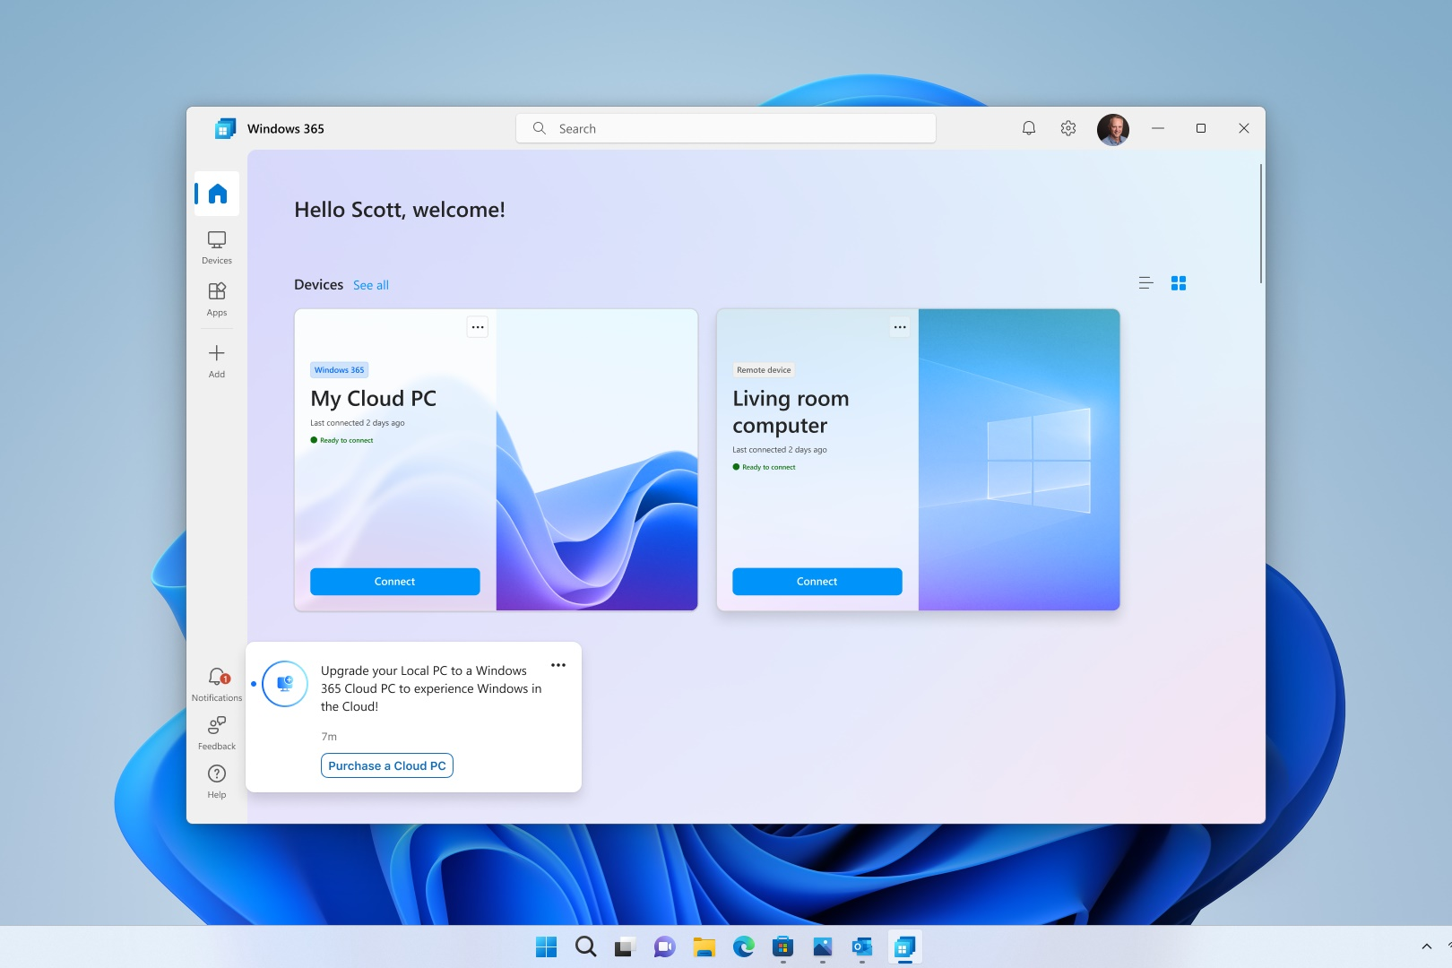
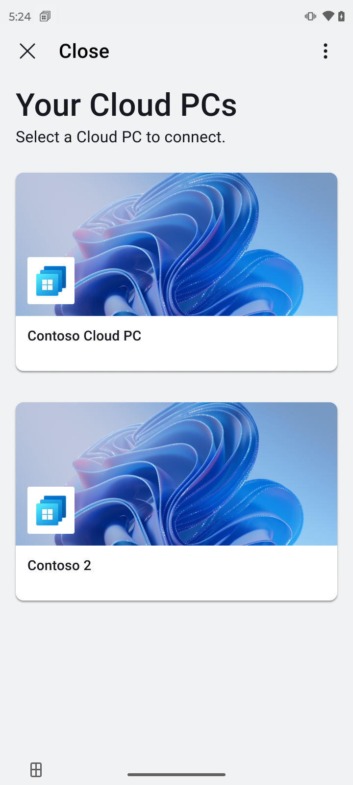
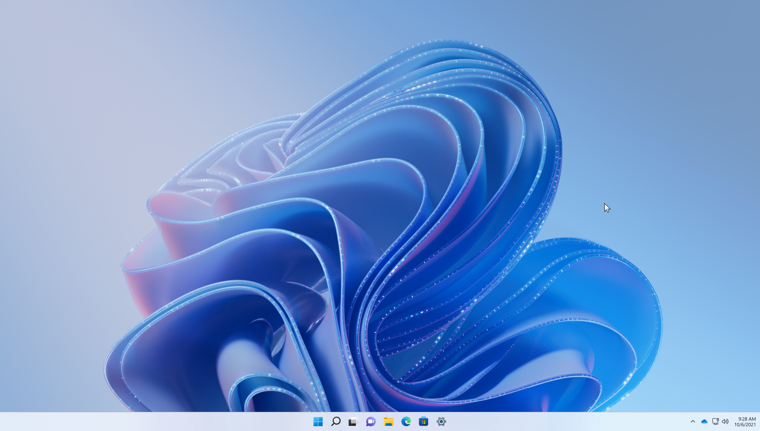
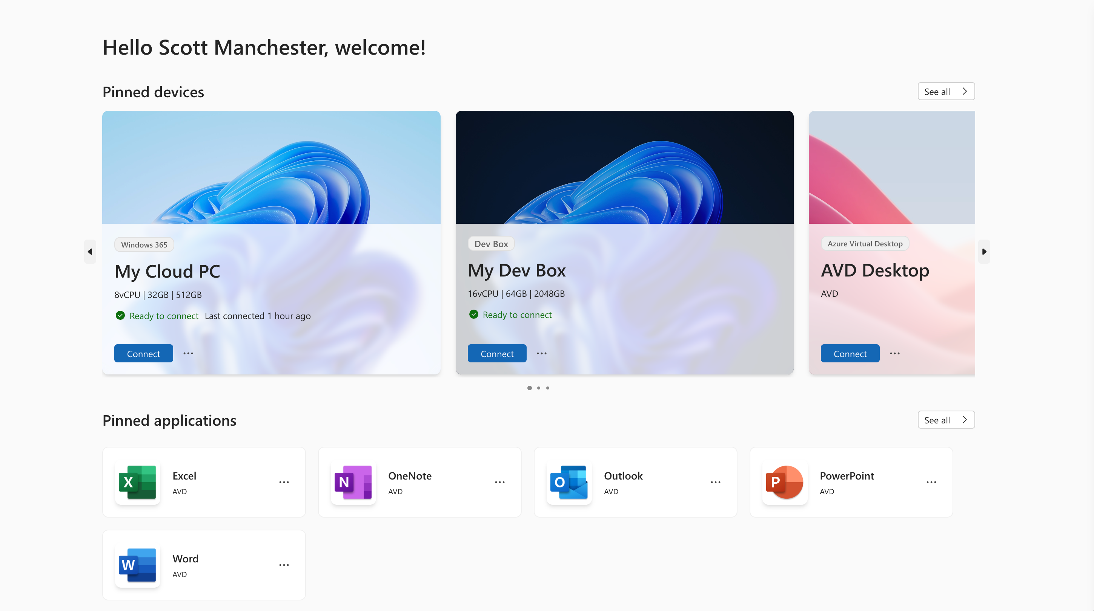
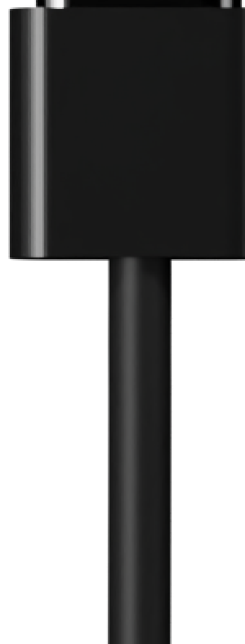
Windows 365 Boot
Boot directly to your Cloud PCs from the initial Windows login screen.
Windows 365 Switch
Switch between your local and Cloud PC from Windows 11 Taskview.
Windows 365 Frontline
Windows 365 Frontline provides frontline, shift and part-time employees a Cloud PC.
Windows App
Our new Unified Client for Windows 365, AVD and RDS across all platform.
Enhanced Android experience
Plug-and-play Windows 365 experience to the Cloud with an external display with ThinkPhone.

Slide 22
Thank you!

